Slide 1
Programming Languages
COP 4020
Functional Languages
Lisp, Scheme, ML, and Haskell

Slide 2
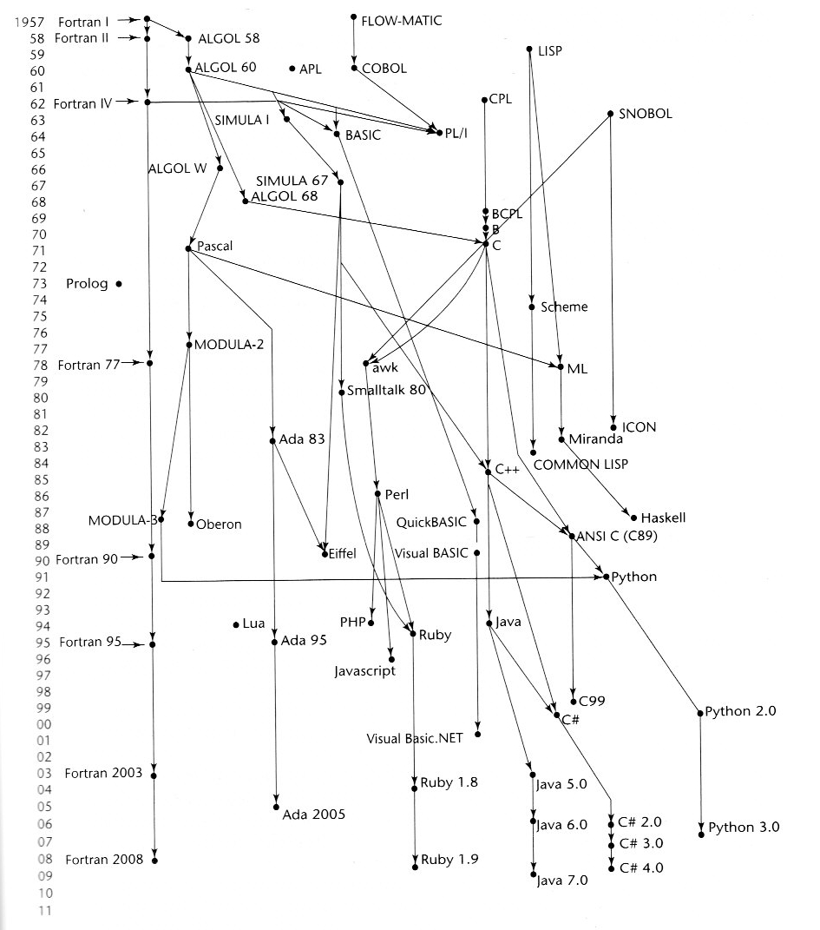

Slide 3
Introduction to Functional
Languages
Procedural languages - emphasis is on procedures, ways to manipulate data structures:
- Efficiency is the primary concern, rather than
the suitability of the language for problem
Functional languages - start with object, apply function - get a new function
- The design of functional languages is based
on mathematical functions
- Functional languages require First class functions
Functional languages typically implement Anonymous functions
Mathematical Functions
- Def: A mathematical function is a mapping of
members of one set, called the domain set, to
another set, called the range set
- A lambda expression specifies the parameter(s)
and the mapping of a function in the following form
λ(x) x * x * x
for the function cube (x) = x * x * x

Slide 4
Mathematical Functions (cont’d)
Lambda expressions describe nameless
functions
- Lambda expressions are applied to parameter(s) by placing the parameter(s) after the expression
e.g. (λ(x) x * x * x)(3)
which evaluates to 27
- Functional Forms
Def: A higher-order function, or functional form,
is one that either takes functions as
parameters or yields a function as its result,
or both
1. Function Composition (Wikipedia)
The application of one function to the results of another.
Form: h ≡ f ° g
which means h (x) ≡ f ( g ( x))

Slide 5
Mathematical Functions (cont’d)
2. Construction
A functional form that takes a list of functions as
the parameters and yields a list of the results of
applying each of its parameter functions to a
given parameter
Form: [f, g]
For f (x) ≡ x * x * x,
g (x) ≡ x + 3,
h (x) ≡ x / 2
[f, g, h] (4) yields (64, 7, 2)
3. Apply-to-all (mapping)
A functional form that takes a single function as
a parameter and yields a list of values obtained
by applying the given function to each element
of a list of parameters
Form: α
For h (x) ≡ x * x * x
α ( h, (3, 2, 4)) yields (27, 8, 64)

Slide 6
Fundamentals of Functional
Programming Languages
- The objective of the design of a FPL is to mimic
mathematical functions to the greatest extent
possible
- The basic process of computation is
fundamentally different in a FPL than in an
imperative language:
  In an imperative language, operations are done and the results are stored in variables for later use. Management of variables is a concern and a source of complexity for imperative programming
  The original motivation for FPL was to avoid needing to store variables, as is the case in mathematics
- In a FPL, the evaluation of a function always
produces the same result given the same
parameters
- This is called referential transparency
Side-trip 1: Javascript
Side Trip 2: Java

Slide 7
Lisp
Procedural languages - emphasis on procedures, ways to manipulate data structures.
Function oriented languages - start with object, apply function - get a new function
LISP
  Implements a “universal function” capable of calculating anything any programming language can calculate.
  This universal function interprets any “S-expression” (Symbolic Expression).
  A Lisp function is just a large S-expression
    (func arg1 arg2 ...)
Critical dates:
  Dartmouth Conference (1956). Birth of Artificial Intelligence. McCarthy got the idea for LISP from IPL2
  LISP (1958) McCarthy joined algebraic ideas from IPL2, the conditional expression from FLPL (Fortran List Processing Language) and the use of recursion to create LisP (List Processing Language)

Slide 8
Lisp
Many Dialects of Lisp exist:
  Common Lisp
  MacLisp
  InterLisp
  Golden Lisp
  Frantz Lisp
All of Lisp is built upon S-expressions
An S-expression is either
  An atom or
  A list
An atom is either
  A numeric atom or
  A non-numeric atom
A list is either
  Empty, that is Nil or (), or
  Consists of a CAR which is an S-expression and CDR which is a list separated by spaces and enclosed by ().
    (Hello world how are you)

Slide 9
Lisp
Elements of Lisp:
Every atom in Lisp can have a value and can represent a function
  The value of an atom is either bound or a lisp expression
  To find the value of an atom, or to evaluate the atom simply write the atom’s name
    > A <enter> > B
    7 unbound atom
digit
numeric
num atom
atom
Nil
character
nonnumeric
expression
atom
list
(expression list)
Nil

Slide 10
Lisp
McCarthy created a function that can compute any computable function.
Lisp is the most important example of a FUNCTIONAL programming language:
  No procedures, only functions (all return something)
  No iteration control, only recursion
Lisp is:
  Interpreted
  Inefficient - all recursive (often remove recursions to iterations to speed up)
  Good at constructing and matching
  Weak at calculating and file handling
  uses garbage collection
Everything in Lisp is an atom or an S-expression. An S-expression is a list whose elements are themselves atoms or S-expressions. There is a special object, Nil, which can be tested in places where either atoms or S-expressions occur. It represents the empty list and is also false.

Slide 11
Lisp
Examples:
  467 is an atom
  ANTIDISESTABLISHMENTARIANISM is an atom
  (How are you) is a list
  (56 (12 (((IM)) fine) (96) abc)) is a list
Lisp functions themselves are S-expressions:
  (plus 6 90)
  (sub 54 33)

Slide 12
Lisp
Lisp has built-in functions, one of which is used to define new functions. The built-in functions are few (simple) and fall into several classes.
List Manipulation Functions
  CONS - builds a new list out of an object and a list
  CAR - Returns the first element of a list
  CDR - Returns the “tail” of a list. (CDR L) is always a list
Testing Functions (return T or Nil)
  EQ - (EQ X Y) tests if the value of X is equal to the value of Y
  NULL - (NULL X) tests if the value of X is Nil
  ATOM - (atom X) test if the value of X is an atom
  Arithmetic functions
    plus or +
    sub or -
    mult or *
    div or /
    ADD1, SUB1
    Logical functions and, or

Slide 13
Function Builders
LAMBDA - used to create an un-named function:
  (LAMBDA (A B)(PLUS A (SUB A B )))
  creates a function with two parameters and calculates A + (A - B)
DEFUN - Creates a named function which can be used later:
  (DEFUN COMP (A B C)
  (MULT A (PLUS B C)
  )
  )
  creates a function COMP with three parameters which, when executed with:
  (COMP X Y Z)
  returns: X * (Y + Z)

Slide 14
Control Structures
COND - The CONDition function is the only control structure in “pure” Lisp, since there is no iteration. COND acts as the If..then..else and CASE statements:
  (COND (test₁ DO₁)
  (test₂ DO₂)
  . . .
  (test_{n} DO_{n})
  )
This code checks each test_{i} until if finds the first true one and then executes the corresponding DO_{i} (returning the value calculated by DO_{i}).
NOTES:
  Lisp doesn’t care if the CONDs are mutually exclusive or collectively exhaustive
  Bohm and Jacopini
    Iteration - in Lisp, recursion
    Sequence - in Lisp, write several things in a row
    Selection - COND

Slide 15
Writing Lisp Functions
Usually, if the function has a list as a parameter, the function will follow these steps:
  1. Start with a COND with the escape or terminating case(s) first, plus any exceptional case handling
  2. Express the function as doing something to the CAR of the list and recursively evaluating the CDR of the list until it reaches the terminating case
    typically a NULL list for non-numerics
    typically 0 (zerop) for numerics
  3. Some functions need a recursive call on the CAR as well as on the CDR
Example: A Boolean function MEMB of two parameters, X and L that tells if X is a member of L.
(DEFUN MEMB (X L)
  (COND (( NULL L) NIL)
    ((ATOMP L) NIL)
    ((EQUAL X (CAR L)) T)
    (T (MEMB X (CDR L)))
  )
)

Slide 16
Lisp Functions
To extend this function to one that will find if X is a member of a nested list L, we must recurse on the CAR and the CDR of the list:
(DEFUN NESTED-MEMB (X L)
  (COND (( NULL L) NIL)
    ((ATOMP L) NIL)
    ((EQUAL X (CAR L)) T)
    (T (OR (NESTED-MEMB X (CAR L))
    (NESTED-MEMB X (CDR L)))
  )
)

Slide 17
Our xLisp Interpreter
Interactive:
> (+ 4 5)
9
> (load “mylisp.lsp”)
; loading “nth.lsp”
T
>
A Reference Manual for xLisp:
xLisp Reference Manual
More on system functions in xLisp

Slide 18
A Lisp Example
This is a Lisp program that counts the number of times a word occurs in an atom list:
(defun make-table (text table)
(cond ((null text) table)
(t (make-table (cdr text)
(update-entry table (car text))))
)
)
(defun update-entry (table word)
(cond ((null table) (list (list word 1)))
((eq word (caar table))
(cons(list word (add1 (cadar table)))
(cdr table)))
(t(cons (car table)
(update-entry (cdr table) word)))
)
)
(defun add1 (n)
(+ n 1)
)

Slide 19
Iteration and Recursion
In theory, any recursive program can be converted to an iterative program.
However:
  The iterative version may require a user-defined stack for intermediate results
  Sometimes it may not be practical to convert a recursive to an iterative function because the resulting program may be overly complicated
  Optimization of “tail recursion” into iteration is a standard compiler optimization technique
Likewise, any iterative program may be converted to a recursive program.

Slide 20
Iteration vs Recursion
Iterative Version - Length of list:
(defun it_length (lst)
(progn (sum)
(setq sum 0)
again
(cond
(null lst (return sum)))
)
(setq sum (add1 sum))
(setq lst (cdr lst))
(go again)
))
Recursive Version:
(defun rec_length (lst)
(cond
((null lst) 0)
(t add1 (rec_length (cdr lst)))
)
)

Slide 21
Property Lists
A list of properties and their values can be kept in the form of a property list:
  (P₁ V₁ P₂ V₂ ... P_{n} V_{n})
This is interpreted as property P_{i} has value V_{i} for each i = 1, 2, ... , n.
The function GETPROP retrieves a value associated with a property:
(defun getprop(p x)
  (cond ((equal(car x) p) (cadr x))
    (t(getprop p (cddr x)))))
Property lists have the problem that they do not permit more than one value to be associated with any given property.

Slide 22
Association Lists
An association list solves this problem by keeping each property - value association as a nested list of items:
  ((P₁ V₁) (P₂ V₂)...(P_{n} V_{n}))
or:
  ((P₁ V₁₁ V₁₂) (P₂ V₂₁ V₂₂ V₂₃)...(P_{n} V_{n}))
Example:
  ((NAME (JANE DOE)) (AGE (23))
  (PHONE (2345 5432)) (SEX (F)) (CHILDREN ()) (SALARY (40K)))
Function ASSOC finds the value ASSOCiated with a given property:
(DEFUN ASSOC (X P) ; same result as
; GETPROP
Same idea as GETPROP except
  Don’t need to look at every other item
  Have to look at the head of the head of the list

Slide 23
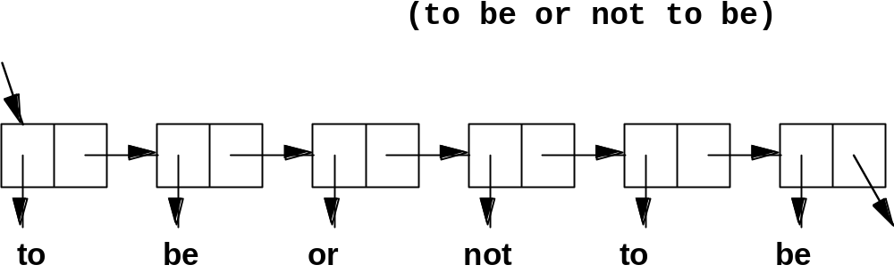
An Atom List

Slide 24
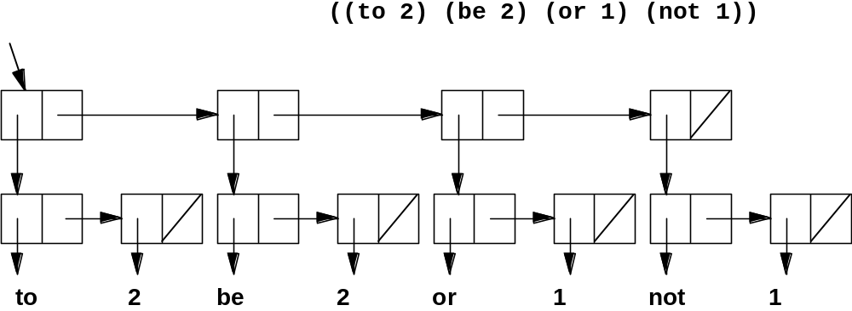
A Property List

Slide 25
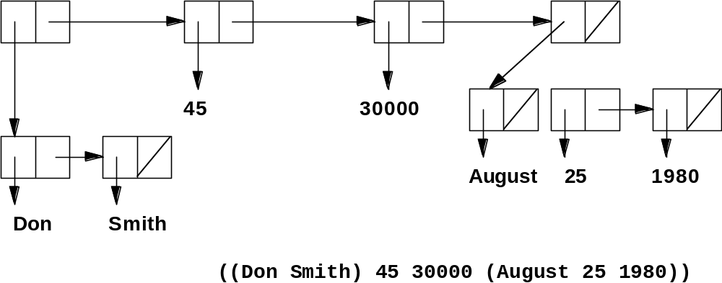
A Nested List

Slide 26
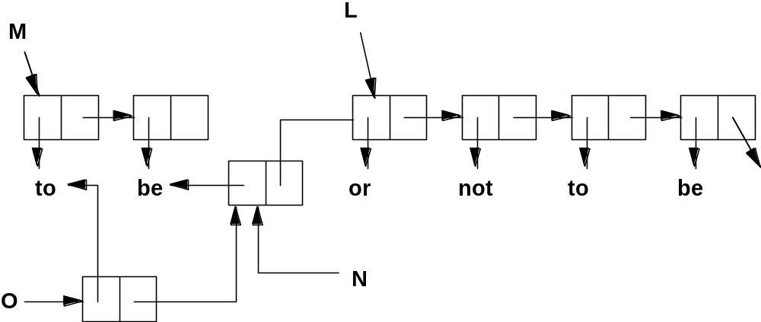
Sharing Sublists

Slide 27
Data and Control Structures
Data Structures
  The list
  May be nested to arbitrary depth
  Data structure constructor - CONS
Control Structures
  Recursion
  Cond
Data Types - may be viewed as weakly typed since no advance checking takes place. Dynamic checking of data types does occur. May be viewed that the language has only one type - S-expression:
  atom
  list
In “pure” Lisp, objects are immutable - no assignments. In “impure” Lisp values can be assigned to variables
No side effects in pure Lisp - nothing is stored.
  DEFUN has side effect - keeps function
  SET and SETQ - can be used to bind atoms and lists

Slide 28
Mapping a Function
Apply a function to each element of the list and return a list of the results
Example:
  (ADD1 3) 4
We can define a “mapping” of this ADD1-MAP so that:
  (ADD1-MAP ‘(3 5 7)) (4 6 8)
The function looks like this:
  (DEFUN ADD1-MAP (L)
  (COND
  ((NULL L) Nil)
  (T (CONS (ADD1 (CAR L))
  (ADD1-MAP (CDR L))
  )
  )
  )
  )

Slide 29
More Functions on Lists
A better approach to mapping functions onto lists is using mapcar, a built in Lisp function that maps any function
onto any list:
  (MAPCAR ‘ADD1 ‘(3 5 7) (4 6 8)
  (MAPCAR ‘ZEROP ‘(4 0 2) (NIL T NIL)
(DEFUN mapcar (func L)
(COND ((NULL L) '())
((ATOM L) nil)
(T (cons (func (car l)) (mapcar (func (CDR L)))))
)
)
Filtering - a list selects a sublist with the specified properties:
  (ZEROP-FILTER ‘(6 0 5 0)) (0 0)
  (ATOMP-FILTER ‘(6 (3 2)(5) 2) (6 2)
Reducing - a list by a binary function and another value that
is applied to produce a single value:
  (PLUS-REDUCE 2 ‘(3 5 6)) 16

Slide 30
More Examples of Lisp
Append function - constructs a new list that is the combination of all the elements on two lists
(defun append (lis1 lis2)
(cond
((null lis1) lis2)
(t (cons (car lis1)
(append (cdr lis1) lis2)))
)
)
(append ‘(A B) ‘(C D R))
returns (A B C D R)
(APPEND ‘((A B) C) ‘(D (E F)))
returns ((A B) C D (E F))
\bin\append2.lsp

Slide 31
More Examples of Lisp
Determining if two lists have the same members:
(defun (eqatlist lis1 lis2)
(cond
((null lis1 (null lis2))
((null lis2) nil)
((= (car lis1) (car lis2))
(eqatlist (cdr lis1) (cdr lis2)))
(t nil)
)
)
(eqatlist ‘(X Y Z) ‘(X Y Z))

Slide 32
Evaluation of Lisp
Lisp has been successful as the programming language for Artificial Intelligence
Well suited to Ill-specified problems
  Dynamic types and flexible data structures are needed. Abstract data types don’t work well for such problems - Lisp gives flexibility
  Interactive, interpreted environments encourage experimentation
Easy to Extend, Preprocess and Generate
  Lisp programs are lists, making it easy to manipulate programs with other Lisp programs
  Extensions for pattern matching, text processing, etc are easy to develop
Inefficiency has discouraged use
  Interpreted
  Depends on recursion
  Dynamic storage allocation is expensive but valuable

Slide 33
Lisp’s Strong Points
Simplicity Principle
  Only one data constructor
  All objects are atoms or lists
  All routines are functions and all functions are defined at the “top level”
  Even functions are lists, so functions can be data
Zero-One-Infinity Principle
  Functions such as +, *, and, or can have any number of arguments
  Lists can be of any length
  Most functions are recursive and need no information about the size of the argument
  There is exactly one copy of every atom used in a Lisp environment
Abstraction Principle
  Creation of “functionals” functions whose values are a function - allow added levels of abstraction

Slide 34
Lisp’s Weak Points
  Lots of Idiotic Single Parentheses
  Unfamiliar, non-mnemonic, awkward notation
  Blatant abuse of the Structure Principle
  Functions with side effects do not obey the Manifest Interface principle
  Practically no security - functions can alter themselves and other functions.

